Slide 1
UPPER SIXTH ARTS
GEOGRAPHY
Quantitative Techniques 4
Plotting and Interpreting Graphical Tools
Notes:
Good morning, class, and welcome to our geography lesson. I am your geography teacher, Mr Kamdem. Today we are starting Quantitative Techniques 4: Plotting and Interpreting Graphical Tools.

Slide 2
CLASS INFO
Class, Chapter and Duration
Class | Upper Sixth Arts
Chapter | Module 8: Understanding and carrying out statistical techniques, topographic map analysis, fieldwork and project based learning
Duration | 2 periods (2 × 50 minutes)
Notes:
This lesson is for Upper Sixth Arts. It belongs to Module 8: Understanding and carrying out statistical techniques, topographic map analysis, fieldwork and project based learning. We shall need 2 periods to cover it.

Slide 3
IDENTIFICATION
Lesson Identification
Topic | Quantitative Techniques in Geography
Sub-topic | Graphical Techniques
Lesson | Quantitative Techniques 4: Plotting and Interpreting Graphical Tools
Notions / Concepts | Bar graph, line graph (simple, compound), ogive, cumulative frequency, climograph, pie chart, triangular graph, scatter graph, line of best fit.
Syllabus focus | Construction, interpretation, advantages and disadvantages of bar graphs, line graphs, ogives, climographs, pie charts, triangular graphs and scatter graphs.
Competence | Learners are able to choose, draw and interpret the main graphs used in geography.
Notes:
Our topic is Quantitative Techniques in Geography, and the sub-topic is Graphical Techniques. The key notions we shall use today are: bar graph, line graph (simple, compound), ogive, cumulative frequency, climograph, pie chart, triangular graph, scatter graph, line of best fit. At the end, you should be able to do this: learners are able to choose, draw and interpret the main graphs used in geography.

Slide 4

HOMEWORK CORRECTION
Correction of the Homework
Question (Quantitative Techniques 3 (Part 3): Measures of Association: Spearman's Rank Correlation):
Name three types of graphs.
Notes:
Before we start the new lesson, let us correct the homework I gave you at the end of Quantitative Techniques 3 (Part 3): Measures of Association: Spearman's Rank Correlation. The question was: Name three types of graphs. Take out your exercise books.

Slide 5
HOMEWORK CORRECTION
Correction: Possible Answer
Bar graphs, line graphs, pie charts, climographs, triangular graphs, scatter graphs or ogives (any three).
Notes:
Here is a good answer. Bar graphs, line graphs, pie charts, climographs, triangular graphs, scatter graphs or ogives (any three). Compare it with your own answer and correct your work in red.

Slide 6
LESSON PLAN
Lesson Plan
Correction of the homework
Objectives and recall
Real-life situation and action to take
Learning activities
Board summary
Evaluation, remediation and homework
Notes:
Here is the plan of our lesson today. First, we shall correct the homework. Then we shall look at the objectives and recall what you already know. After that, we shall study a situation from real life and the action to take, and do the learning activities. Finally, we shall copy the board summary, do the evaluation and the remediation, and I will give you the homework.

Slide 7
OBJECTIVES
Objectives
By the end of this lesson, you should be able to:
Draw and interpret vertical and horizontal bar graphs.
Draw and interpret simple and compound line graphs.
Notes:
Take your time to copy this part; we will continue together.

Slide 8
OBJECTIVES
Objectives (continued)
Draw an ogive and read the median.
Draw a climograph and a pie chart.
Plot triangular and scatter graphs and interpret them.
Notes:
By the end of this lesson, you should be able to do five things. Number 1: draw and interpret vertical and horizontal bar graphs. Number 2: draw and interpret simple and compound line graphs. Number 3: draw an ogive and read the median. Number 4: draw a climograph and a pie chart. Number 5: plot triangular and scatter graphs and interpret them.

Slide 9
PREVIOUS KNOWLEDGE
Previous Knowledge
Rs measures the relationship between two variables.
The median divides data into two halves.
Climate data include temperature and rainfall.
Notes:
Let us first remember what you already know. Rs measures the relationship between two variables. The median divides data into two halves. Climate data include temperature and rainfall. Keep this in mind, because we shall build on it today.

Slide 10
REAL-LIFE SITUATION
Situation in Real Life
For his project on Garoua, a student has tables of rainfall and temperature, maize production by region, the shares of products at an agricultural show, soil samples and altitudes of weather stations.
His teacher tells him that each set of data needs the right graph.
Notes:
Take your time to copy this part; we will continue together.

Slide 11
REAL-LIFE SITUATION
Situation in Real Life (continued)
He asks: "Which graph should I use for each set of data, how do I draw it correctly, and how do I interpret it?"
Notes:
Listen carefully to this situation from real life. For his project on Garoua, a student has tables of rainfall and temperature, maize production by region, the shares of products at an agricultural show, soil samples and altitudes of weather stations. His teacher tells him that each set of data needs the right graph. He asks: "Which graph should I use for each set of data, how do I draw it correctly, and how do I interpret it?" Think about it, because I am going to ask you some questions.

Slide 12
REAL-LIFE SITUATION
Situation: Question 1
What is the problem in the situation?
Notes:
Question 1: What is the problem in the situation? Think for a moment, then raise your hand to answer.

Slide 13
REAL-LIFE SITUATION
Answer
The student does not know how to choose, draw and interpret graphs.
Notes:
Good. The student does not know how to choose, draw and interpret graphs.

Slide 14
REAL-LIFE SITUATION
Situation: Question 2
Which graph shows rainfall and temperature together?
Notes:
Question 2: Which graph shows rainfall and temperature together? Think for a moment, then raise your hand to answer.

Slide 15
REAL-LIFE SITUATION
Answer
The climograph.
Notes:
Good. The climograph.

Slide 16
REAL-LIFE SITUATION
Situation: Question 3
Which graph shows parts of a whole?
Notes:
Question 3: Which graph shows parts of a whole? Think for a moment, then raise your hand to answer.

Slide 17
REAL-LIFE SITUATION
Possible Answer
The pie chart.
Notes:
Good. The pie chart.

Slide 18
ACTION TO TAKE
Action to Take
Always give a graph a title, labelled axes with units, a suitable scale and a key.
Notes:
From this situation, the action we are working towards in this lesson is the following: always give a graph a title, labelled axes with units, a suitable scale and a key.

Slide 19
JUSTIFICATION
Justification of the Lesson
This lesson gives the graphical skills needed in projects, fieldwork reports and practical examinations.
Notes:
Why is this lesson important for you? This lesson gives the graphical skills needed in projects, fieldwork reports and practical examinations.

Slide 20
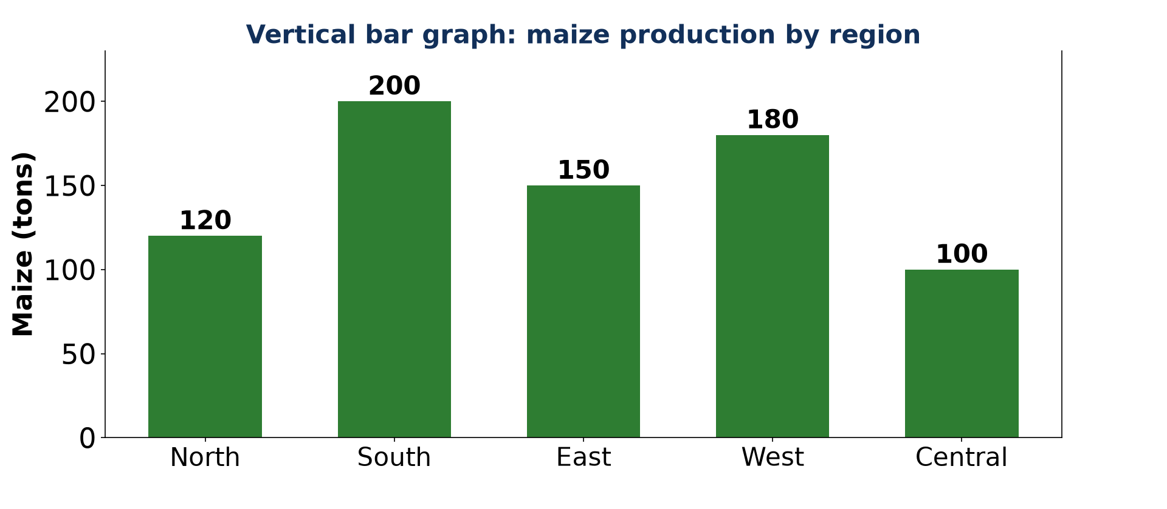
1. BAR AND LINE GRAPHS
Activity 1
A vertical bar graph.
Notes:
Activity 1. Look carefully at this picture: a vertical bar graph. Observe every detail before I ask the question.

Slide 21
1. BAR AND LINE GRAPHS
Activity 1: Question
Which region produces the most maize?
Notes:
Here is the question for Activity 1: Which region produces the most maize? Take one minute to think and write your answer in your rough notebook.

Slide 22
1. BAR AND LINE GRAPHS
Activity 1: Answer
The South (200 tons).
Notes:
Let us check the answer together. The South (200 tons).

Slide 23
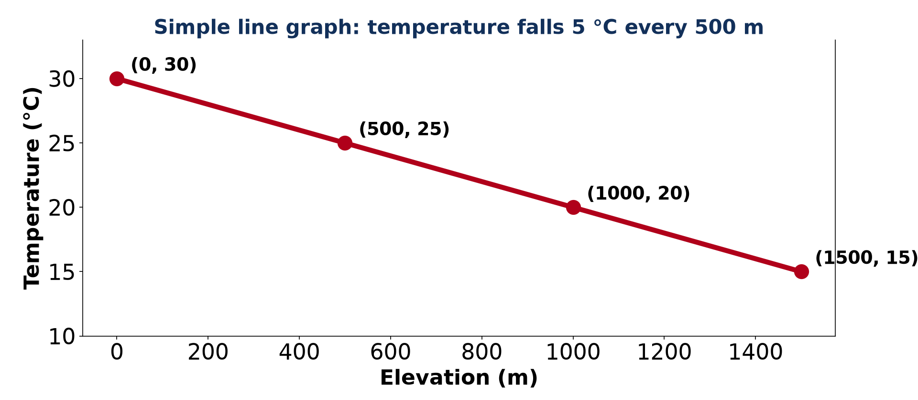
1. BAR AND LINE GRAPHS
Activity 2
A simple line graph.
Notes:
Activity 2. Look carefully at this picture: a simple line graph. Observe every detail before I ask the question.

Slide 24
1. BAR AND LINE GRAPHS
Activity 2: Question
By how much does temperature fall for every 500 m?
Notes:
Here is the question for Activity 2: By how much does temperature fall for every 500 m? Take one minute to think and write your answer in your rough notebook.

Slide 25
1. BAR AND LINE GRAPHS
Activity 2: Answer
5 °C.
Notes:
Let us check the answer together. 5 °C.

Slide 26
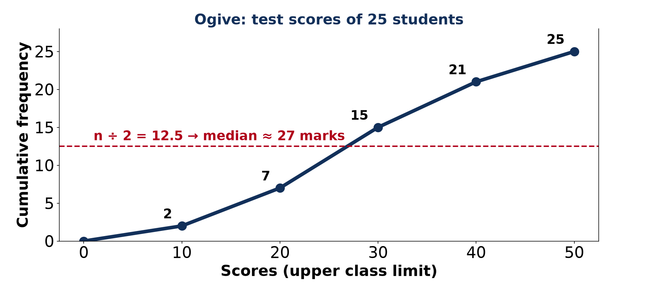
2. OGIVE AND CLIMOGRAPH
Activity 3
An ogive.
Notes:
Activity 3. Look carefully at this picture: an ogive. Observe every detail before I ask the question.

Slide 27
2. OGIVE AND CLIMOGRAPH
Activity 3: Question
Which value is used on the x-axis of an ogive?
Notes:
Here is the question for Activity 3: Which value is used on the x-axis of an ogive? Take one minute to think and write your answer in your rough notebook.

Slide 28
2. OGIVE AND CLIMOGRAPH
Activity 3: Answer
The upper limit of each class.
Notes:
Let us check the answer together. The upper limit of each class.

Slide 29
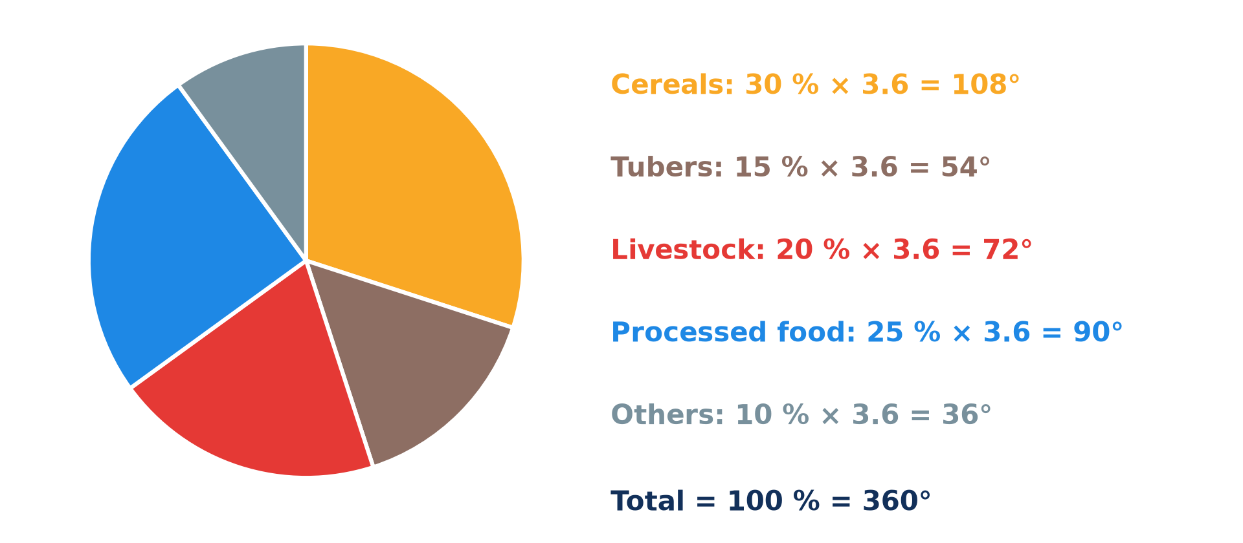
3. PIE CHART
Activity 4
A pie chart.
Notes:
Activity 4. Look carefully at this picture: a pie chart. Observe every detail before I ask the question.

Slide 30
3. PIE CHART
Activity 4: Question
How many degrees represent 25 %?
Notes:
Here is the question for Activity 4: How many degrees represent 25 %? Take one minute to think and write your answer in your rough notebook.

Slide 31
3. PIE CHART
Activity 4: Answer
25 × 3.6 = 90°.
Notes:
Let us check the answer together. 25 × 3.6 = 90°.

Slide 32
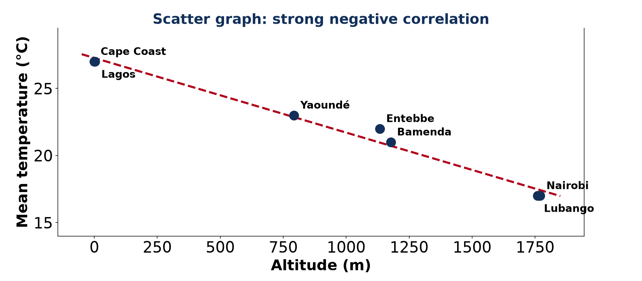
4. SCATTER GRAPH
Activity 5
Altitude and temperature.
Notes:
Activity 5. Look carefully at this picture: altitude and temperature. Observe every detail before I ask the question.

Slide 33
4. SCATTER GRAPH
Activity 5: Question
What type of correlation does this scatter graph show?
Notes:
Here is the question for Activity 5: What type of correlation does this scatter graph show? Take one minute to think and write your answer in your rough notebook.

Slide 34
4. SCATTER GRAPH
Activity 5: Answer
A strong negative correlation.
Notes:
Let us check the answer together. A strong negative correlation.

Slide 35
BOARD SUMMARY
Board Summary
Topic: Quantitative Techniques in Geography
Sub-topic: Graphical Techniques
Quantitative Techniques 4: Plotting and Interpreting Graphical Tools
Notes:
Now we are going to copy the board summary. Write the title and the headings neatly in your notebooks. I will give you enough time for each slide, so do not rush.

Slide 36
BOARD SUMMARY
DEFINITIONS
The key terms of this lesson are defined as follows:
Bar graph: It is a graph using bars whose length shows the value of each category.
Line graph: It is a graph joining points to show change over time or the relationship between two variables.
Notes:
Let us copy the definitions. The key terms of this lesson are defined as follows. On this slide we have Bar graph and Line graph. Write each point on a new line, with the key term first, and explain it in your own words when we revise. When you finish, we go to the next slide.

Slide 37
BOARD SUMMARY
DEFINITIONS (continued)
Ogive: It is a cumulative frequency curve.
Climograph: It is a graph combining rainfall (bars) and temperature (line) of a station.
Scatter graph: It is a graph of points showing the relationship between two numerical variables.
Notes:
We continue with the definitions. On this slide we have Ogive, Climograph and Scatter graph. Write each point on a new line, with the key term first, and explain it in your own words when we revise.

Slide 38
BOARD SUMMARY
1. Bar Graphs
Bar graphs are drawn and used as follows:
Types: Vertical bars suit short category names; horizontal bars suit long names.
Illustration: a vertical bar graph
Notes:
Let us copy Bar Graphs. Bar graphs are drawn and used as follows. Copy the point on Types on the left, then draw the diagram on the right: a vertical bar graph. Give it a title and label it clearly.

Slide 39
BOARD SUMMARY
1. Bar Graphs
Steps:
Choose the data and the type.
Draw the axes: categories and values.
Choose an even scale.
Draw bars of equal width and spacing with a ruler.
Notes:
We continue with Bar Graphs. On this slide we have Steps. Write each point on a new line, with the key term first, and explain it in your own words when we revise. When you finish, we go to the next slide.

Slide 40
BOARD SUMMARY
1. Bar Graphs (continued)
Add a title, axis labels with units and a key.
Notes:
We continue with Bar Graphs. Copy this carefully.

Slide 41
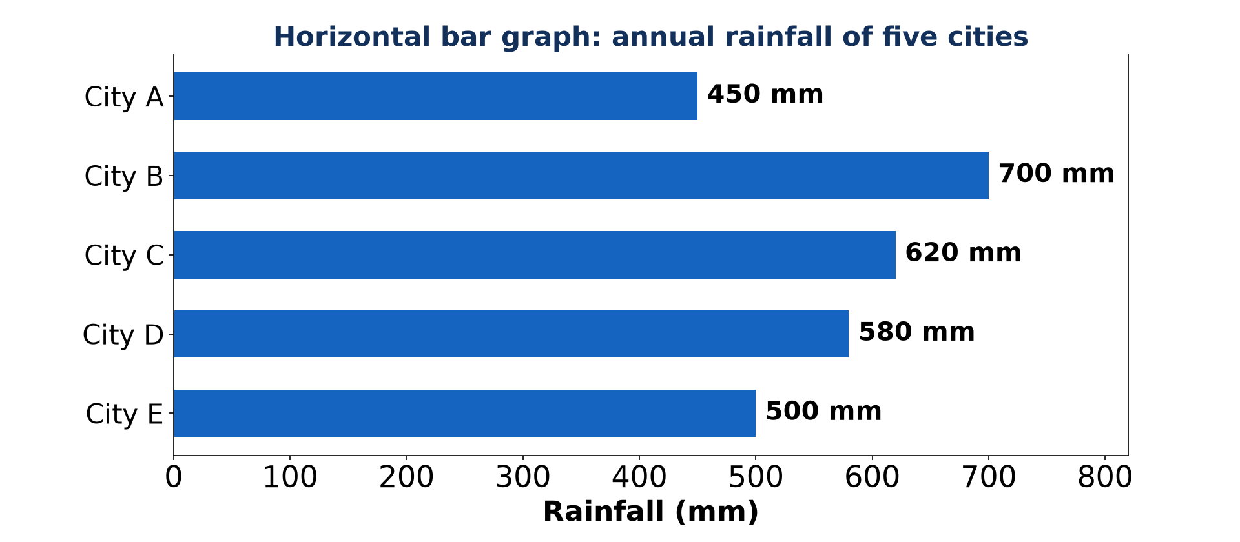
BOARD SUMMARY
1. Bar Graphs
Interpretation: Maize: the South leads (200 t) and the Centre is lowest (100 t); rainfall: City B is wettest (700 mm) and City A driest (450 mm).
Illustration: a horizontal bar graph
Notes:
Copy the point on Interpretation on the left, then draw the diagram on the right: a horizontal bar graph. Give it a title and label it clearly.

Slide 42
BOARD SUMMARY
1. Bar Graphs
Assessment:
Advantages: easy to draw and read; good for comparing categories.
Disadvantages: unsuitable for continuous data; cluttered with too many bars.
Notes:
We continue with Bar Graphs. On this slide we have Assessment. Write each point on a new line, with the key term first, and explain it in your own words when we revise.

Slide 43
BOARD SUMMARY
2. Line Graphs
Line graphs are drawn and used as follows:
Types: A simple line graph shows one set of data; a compound line graph shows several sets with a key.
Notes:
Let us copy Line Graphs. Line graphs are drawn and used as follows. On this slide we have Types. Write each point on a new line, with the key term first, and explain it in your own words when we revise.

Slide 44
BOARD SUMMARY
2. Line Graphs
Steps: Put the independent variable (time, altitude) on the x-axis and the dependent variable on the y-axis, plot the points and join them with a ruler.
Illustration: a simple line graph
Notes:
Copy the point on Steps on the left, then draw the diagram on the right: a simple line graph. Give it a title and label it clearly.

Slide 45
BOARD SUMMARY
2. Line Graphs
Example: Temperature falls from 30 °C at sea level to 15 °C at 1,500 m: 5 °C every 500 m.
Assessment:
Advantages: shows trends and allows prediction.
Notes:
We continue with Line Graphs. On this slide we have Example and Assessment. Write each point on a new line, with the key term first, and explain it in your own words when we revise. When you finish, we go to the next slide.

Slide 46
BOARD SUMMARY
2. Line Graphs (continued)
Disadvantages: several lines confuse; it shows trends but not causes.
Notes:
We continue with Line Graphs. Copy this carefully.

Slide 47
BOARD SUMMARY
3. Ogives and Climographs
Ogives and climographs are drawn and used as follows:
Ogive steps: Make a frequency table, add frequencies progressively and plot cumulative frequency against the upper class limits.
Illustration: an ogive
Notes:
Let us copy Ogives and Climographs. Ogives and climographs are drawn and used as follows. Copy the point on Ogive steps on the left, then draw the diagram on the right: an ogive. Give it a title and label it clearly.

Slide 48
BOARD SUMMARY
3. Ogives and Climographs
Ogive example: Scores of 25 students give points (10, 2), (20, 7), (30, 15), (40, 21) and (50, 25); the median (12.5th student) is about 27 marks.
Notes:
We continue with Ogives and Climographs. On this slide we have Ogive example. Write each point on a new line, with the key term first, and explain it in your own words when we revise.

Slide 49

BOARD SUMMARY
3. Ogives and Climographs
Climograph steps: Months on the x-axis, rainfall as bars on one y-axis and temperature as a line on the other.
Illustration: the climograph of Garoua
Notes:
Copy the point on Climograph steps on the left, then draw the diagram on the right: the climograph of Garoua. Give it a title and label it clearly.

Slide 50
BOARD SUMMARY
3. Ogives and Climographs
Climograph of Garoua: It shows a rainy season from May to September–October with a peak in August, and a hot dry season with a maximum in March–April.
Notes:
We continue with Ogives and Climographs. On this slide we have Climograph of Garoua. Write each point on a new line, with the key term first, and explain it in your own words when we revise. When you finish, we go to the next slide.

Slide 51
BOARD SUMMARY
3. Ogives and Climographs (continued)
Assessment:
Advantages: ogives give medians and quartiles; climographs compare rainfall and temperature month by month.
Disadvantages: ogives hide class frequencies; two axes may confuse readers.
Notes:
We continue with Ogives and Climographs. On this slide we have Assessment. Write each point on a new line, with the key term first, and explain it in your own words when we revise.

Slide 52
BOARD SUMMARY
4. Pie Charts and Triangular Graphs
Pie charts and triangular graphs are drawn and used as follows:
Pie chart steps: Convert values to percentages, then to degrees (% × 3.6), and draw the sectors with a protractor.
Illustration: a pie chart
Notes:
Let us copy Pie Charts and Triangular Graphs. Pie charts and triangular graphs are drawn and used as follows. Copy the point on Pie chart steps on the left, then draw the diagram on the right: a pie chart. Give it a title and label it clearly.

Slide 53
BOARD SUMMARY
4. Pie Charts and Triangular Graphs
Pie chart example: At the Ebolowa agricultural show, cereals 30 % (108°), processed food 25 % (90°), livestock 20 % (72°), tubers 15 % (54°) and others 10 % (36°).
Notes:
We continue with Pie Charts and Triangular Graphs. On this slide we have Pie chart example. Write each point on a new line, with the key term first, and explain it in your own words when we revise.

Slide 54
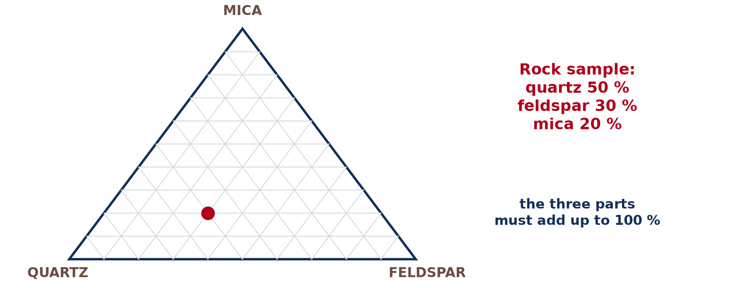
BOARD SUMMARY
4. Pie Charts and Triangular Graphs
Triangular graph: It shows three components that total 100 %, such as a rock of 50 % quartz, 30 % feldspar and 20 % mica, or soil texture.
Illustration: a triangular graph
Notes:
Copy the point on Triangular graph on the left, then draw the diagram on the right: a triangular graph. Give it a title and label it clearly.

Slide 55
BOARD SUMMARY
4. Pie Charts and Triangular Graphs
Assessment:
Advantages: pie charts show shares of a whole; triangular graphs compare many samples of three parts.
Disadvantages: pies are poor for many categories; triangular graphs are hard for beginners.
Notes:
We continue with Pie Charts and Triangular Graphs. On this slide we have Assessment. Write each point on a new line, with the key term first, and explain it in your own words when we revise.

Slide 56
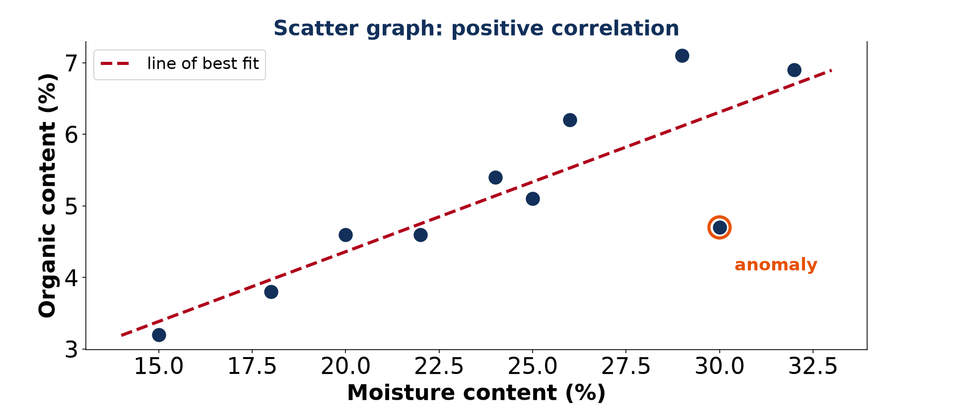
BOARD SUMMARY
5. Scatter Graphs
Scatter graphs are drawn and used as follows:
Steps: Put the independent variable on the x-axis, plot each pair as a dot, and draw a line of best fit by eye with equal points on both sides.
Illustration: a positive correlation
Notes:
Let us copy Scatter Graphs. Scatter graphs are drawn and used as follows. Copy the point on Steps on the left, then draw the diagram on the right: a positive correlation. Give it a title and label it clearly.

Slide 57
BOARD SUMMARY
5. Scatter Graphs
Example 1: Moisture and organic content of soils rise together: a positive correlation, with one anomaly.
Notes:
We continue with Scatter Graphs. On this slide we have Example 1. Write each point on a new line, with the key term first, and explain it in your own words when we revise.

Slide 58
BOARD SUMMARY
5. Scatter Graphs
Example 2: Altitude and temperature: Nairobi (1,770 m) and Lubango have 17 °C, while Lagos and Cape Coast at sea level have 27 °C: a strong negative correlation.
Illustration: altitude and temperature
Notes:
Copy the point on Example 2 on the left, then draw the diagram on the right: altitude and temperature. Give it a title and label it clearly.

Slide 59
BOARD SUMMARY
5. Scatter Graphs
Assessment:
Advantages: shows direction and strength of relationships and outliers.
Disadvantages: only two variables; a trend does not prove a cause.
Notes:
We continue with Scatter Graphs. On this slide we have Assessment. Write each point on a new line, with the key term first, and explain it in your own words when we revise.

Slide 60
FORMATIVE EVALUATION
Evaluation 1
Which graph would you choose for the percentages of workers in three sectors, and why?
Notes:
Now let us check what you have understood. Question 1: Which graph would you choose for the percentages of workers in three sectors, and why? Answer in your exercise book.

Slide 61
FORMATIVE EVALUATION
Expected Answer
A pie chart (or a triangular graph for several countries), because the parts make a whole of 100 %.
Notes:
The expected answer is: a pie chart (or a triangular graph for several countries), because the parts make a whole of 100 %. If you got it right, well done.

Slide 62
FORMATIVE EVALUATION
Evaluation 2
Give one advantage and one disadvantage of a climograph.
Notes:
Now let us check what you have understood. Question 2: Give one advantage and one disadvantage of a climograph. Answer in your exercise book.

Slide 63
FORMATIVE EVALUATION
Expected Answer
Advantage: shows rainfall and temperature together; disadvantage: two vertical axes may confuse readers.
Notes:
The expected answer is: advantage: shows rainfall and temperature together; disadvantage: two vertical axes may confuse readers. If you got it right, well done.

Slide 64
REMEDIATION
Remediation
Fill in the blanks:
In a pie chart, 1 % = ______°.
An ogive uses the ______ class limits.
On a climograph, rainfall is shown by ______.
Notes:
For those who need more practice, fill in the blanks in your exercise book. The answers are: number 1, ; number 3, 6; number 2, upper; number 3, bars.

Slide 65
HOMEWORK
Homework
Name the instrument that gives geographical coordinates by satellite.
Notes:
For your homework: Name the instrument that gives geographical coordinates by satellite. We shall correct it at the beginning of our next lesson.

Slide 66
NEXT LESSON
Next Lesson
Our next lesson will be on:
Field Work 1: Getting Geographical Coordinates
Notes:
Our next lesson will be on Field Work 1: Getting Geographical Coordinates. Thank you for your attention, and see you next time.

Slide 67
BILINGUAL GAME
Bilingual Game (Jeu Bilingue)
English | Français
Bar graph | Le diagramme en barres
Line graph | La courbe
Pie chart | Le diagramme circulaire
Scatter graph | Le nuage de points
Cumulative frequency | La fréquence cumulée
Line of best fit | La droite d'ajustement
Notes:
Let us play the bilingual game. I say a word in English, and you give me the French word. Then we do the reverse.

Slide 68
LOGBOOK
Official Logbook (1/2)
Module / Topic | Quantitative Techniques in Geography
Lesson Title | Quantitative Techniques 4: Plotting and Interpreting Graphical Tools
Expected Learning Outcomes | Draw and interpret vertical and horizontal bar graphs. Draw and interpret simple and compound line graphs. Draw an ogive and read the median. Draw a climograph and a pie chart. Plot triangular and scatter graphs and interpret them.
Competence | Learners are able to choose, draw and interpret the main graphs used in geography.
Notes:
I record this information in the official logbook of the class after the lesson.

Slide 69
LOGBOOK
Official Logbook (2/2)
Matter Taught | DEFINITIONS; Bar Graphs; Line Graphs; Ogives and Climographs; Pie Charts and Triangular Graphs; Scatter Graphs.
Evaluation | Formative evaluation and remediation exercise.
Homework | Name the instrument that gives geographical coordinates by satellite.
Enrolment / Present / Absent | ____ / ____ / ____
Achievement | To be completed after the lesson.
Notes:
I complete the second page of the logbook: the matter taught, the evaluation, the homework and the attendance.

Slide 70
TEACHER'S NOTE
Teacher's Note
Timing: Homework correction, plan, objectives 8 min | Recall, situation, action 10 min | 5 activities 30 min | Board summary (copying) 30 min | Evaluation, remediation 10 min | Homework, next lesson 5 min | Logbook 7 min
Without the projector (Activity 1): draw the bars on squared paper.
Without the projector (Activity 2): plot the four points.
Without the projector (Activity 3): calculate the cumulative frequencies.
Without the projector (Activity 4): draw the pie with a protractor.
Without the projector (Activity 5): draw the line of best fit by eye.
Notes:
This slide is for me, the teacher: it gives the timing of the lesson and what to do if the projector is not available.

Slide 71
REFERENCES
References
Geography Syllabus for Sixth Forms (Lower and Upper Sixth), MINESEC, 2019 — Module 8 (Practical Geography).
Teacher's course notes: Mr KAMDEM E., Statistical Techniques in Geographical Analysis (USA), GBHS Garoua, 2026.
Diagrams and animations: drawn for this lesson (Geography Department).
Notes:
These are the references and picture credits used to prepare this lesson.

